Slide 1
Sunday club 7 June 2020
Trinity SUnday

Slide 2


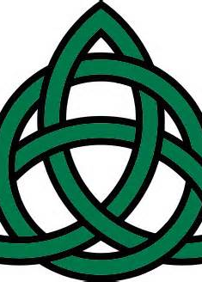
Today we are going to explore what “trinity” means?
The word trinity means 3 in 1.
Can you think about any objects that are made up of three ……
Look at the next page for some ideas.
This Photo by Unknown Author is licensed under CC BY

Slide 3


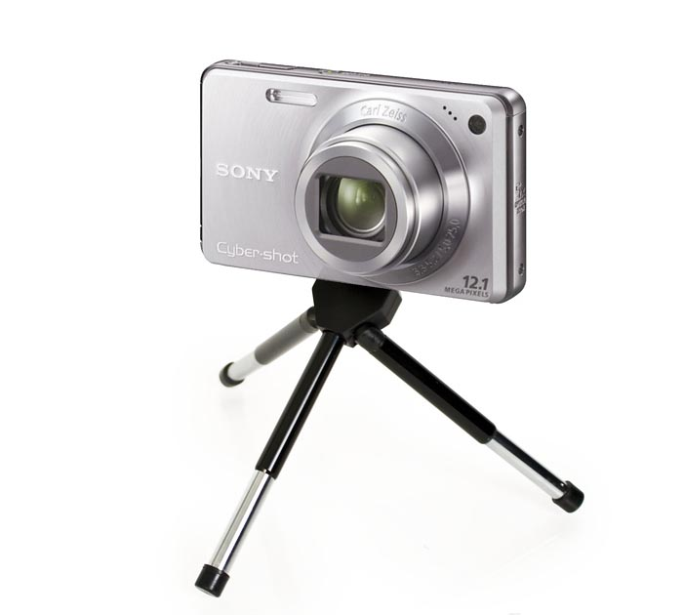
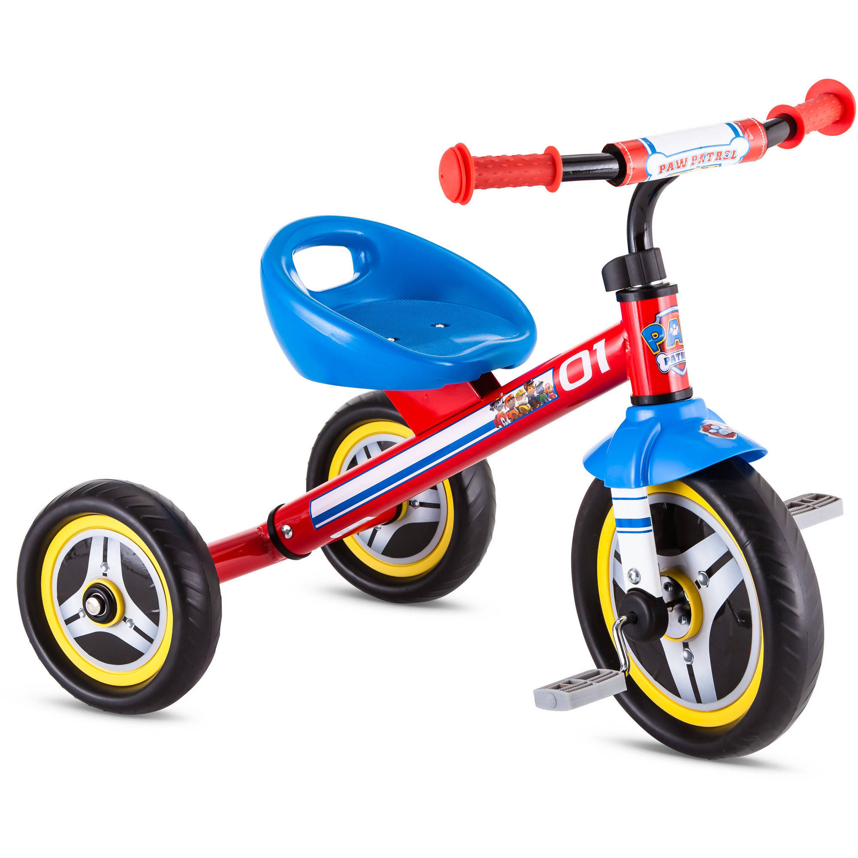
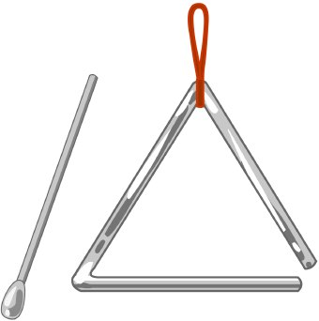
Trinity
Spot the three in 1
This Photo by Unknown Author is licensed under CC BY-SA-NC

Slide 4
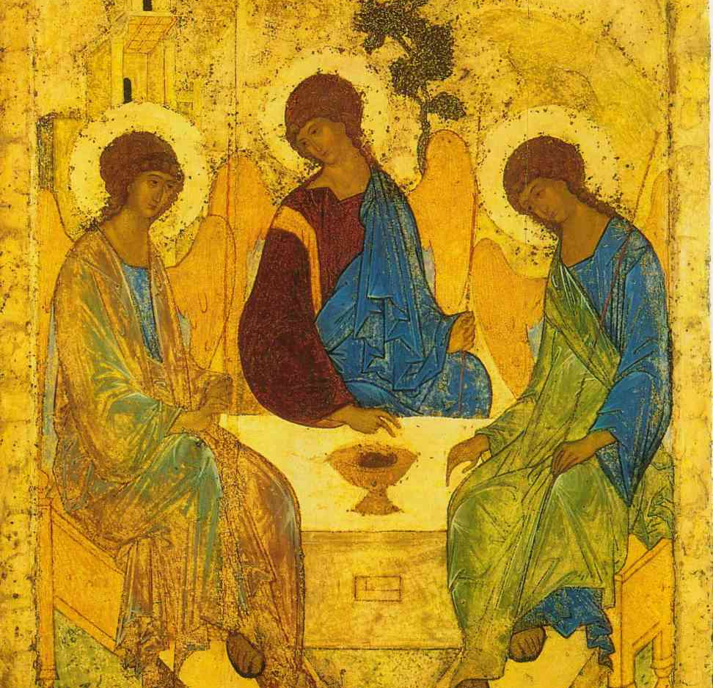
Now watch this very short clip
The characters try to explain a little about Trinity- God three in one.
https://www.youtube.com/watch?v=n-1AdUwbWLw
This Photo by Unknown Author is licensed under CC BY-NC-ND

Slide 5
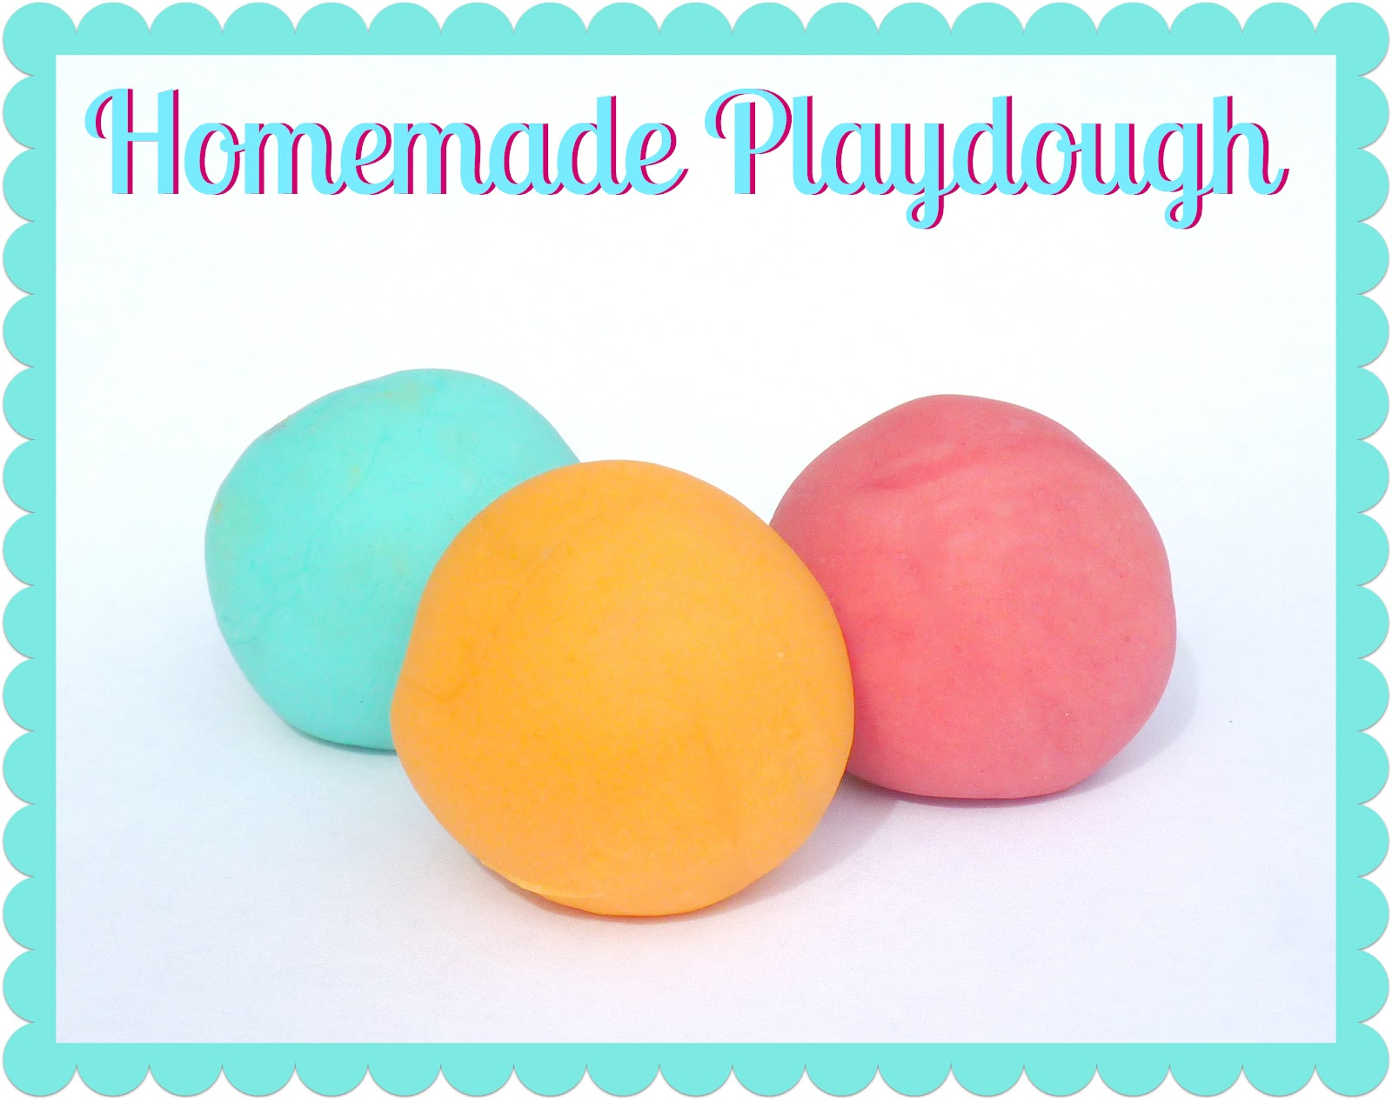
Task: we are going to try and demonstrate a way of understanding the Trinity.
You will need:
1 cup of flour – imagine this is God the father-White is a symbol of purity
½ cup of salt- imagine this is God the son. “You are the salt of the earth”
½ cup of water- imagine this is God the Holy Spirit Water is often linked with the Holy Spirit in the Bible.
Instruction- take each, put it in a bowl and mix together. What do we get?
…… A single item of Play dough
This Photo by Unknown Author is licensed under CC BY-SA-NC

Slide 6
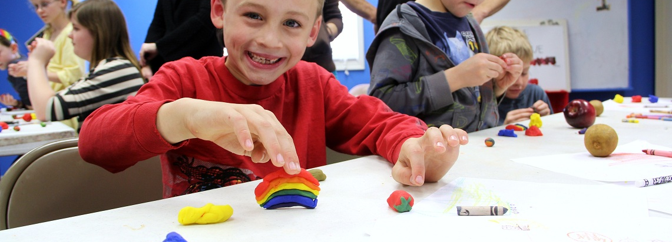
The Playdough is like God- made up of three that is one
You could add some food colourings to make bits of your playdough different
This Photo by Unknown Author is licensed under CC BY-SA-NC

Slide 7
Christians believe in One God
The Bible says... “God gave us his love through the Holy Spirit whom God has given to us.”
Romans 5:5

Slide 8
A Prayer for Children on trinity Sunday
Sunday 7 June, Trinity Sunday
We bind to ourselves this day,
the strong name of the Trinity,
the three in one and one in three,
wrapping ourselves in God’s presence.
We pray for all who are exhausted,
for young people caring for people older than themselves,
for those caring for younger siblings.
For children who have had to grow up too quickly.
We remember the words of Isaiah:
even youths will faint and be weary,
and the young will fall exhausted;
but those who wait for the Lord shall renew their strength,
they shall mount up with wings like eagles,
they shall run and not be weary,
they shall walk and not faint.
Be with us, Lord, as we wait for you. Amen

Slide 9
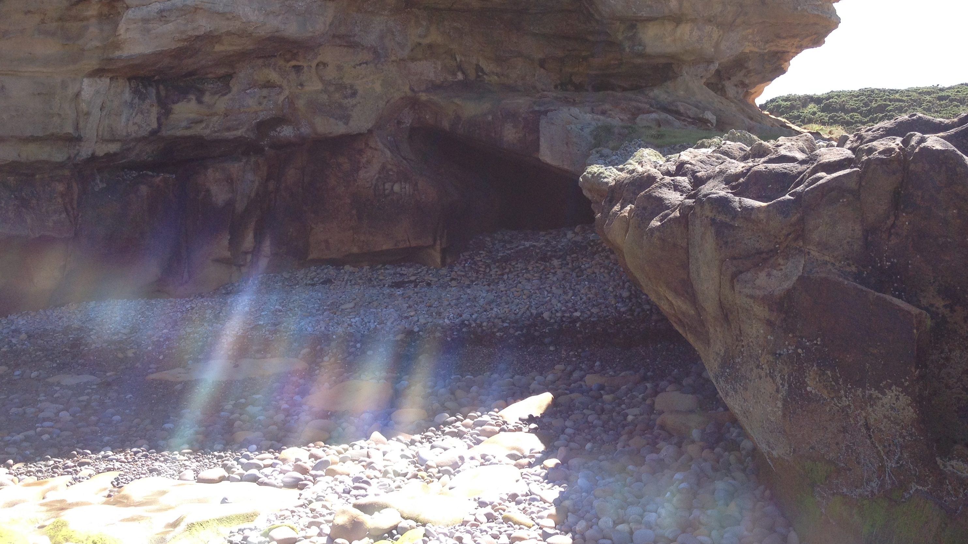
Enjoy playing with the Playdough and we send you special blessings from GLS for the coming week.
Remember the Trinity of God is with you ….

