Slide 1

Sunday Club
14th Feb 2021

Slide 2


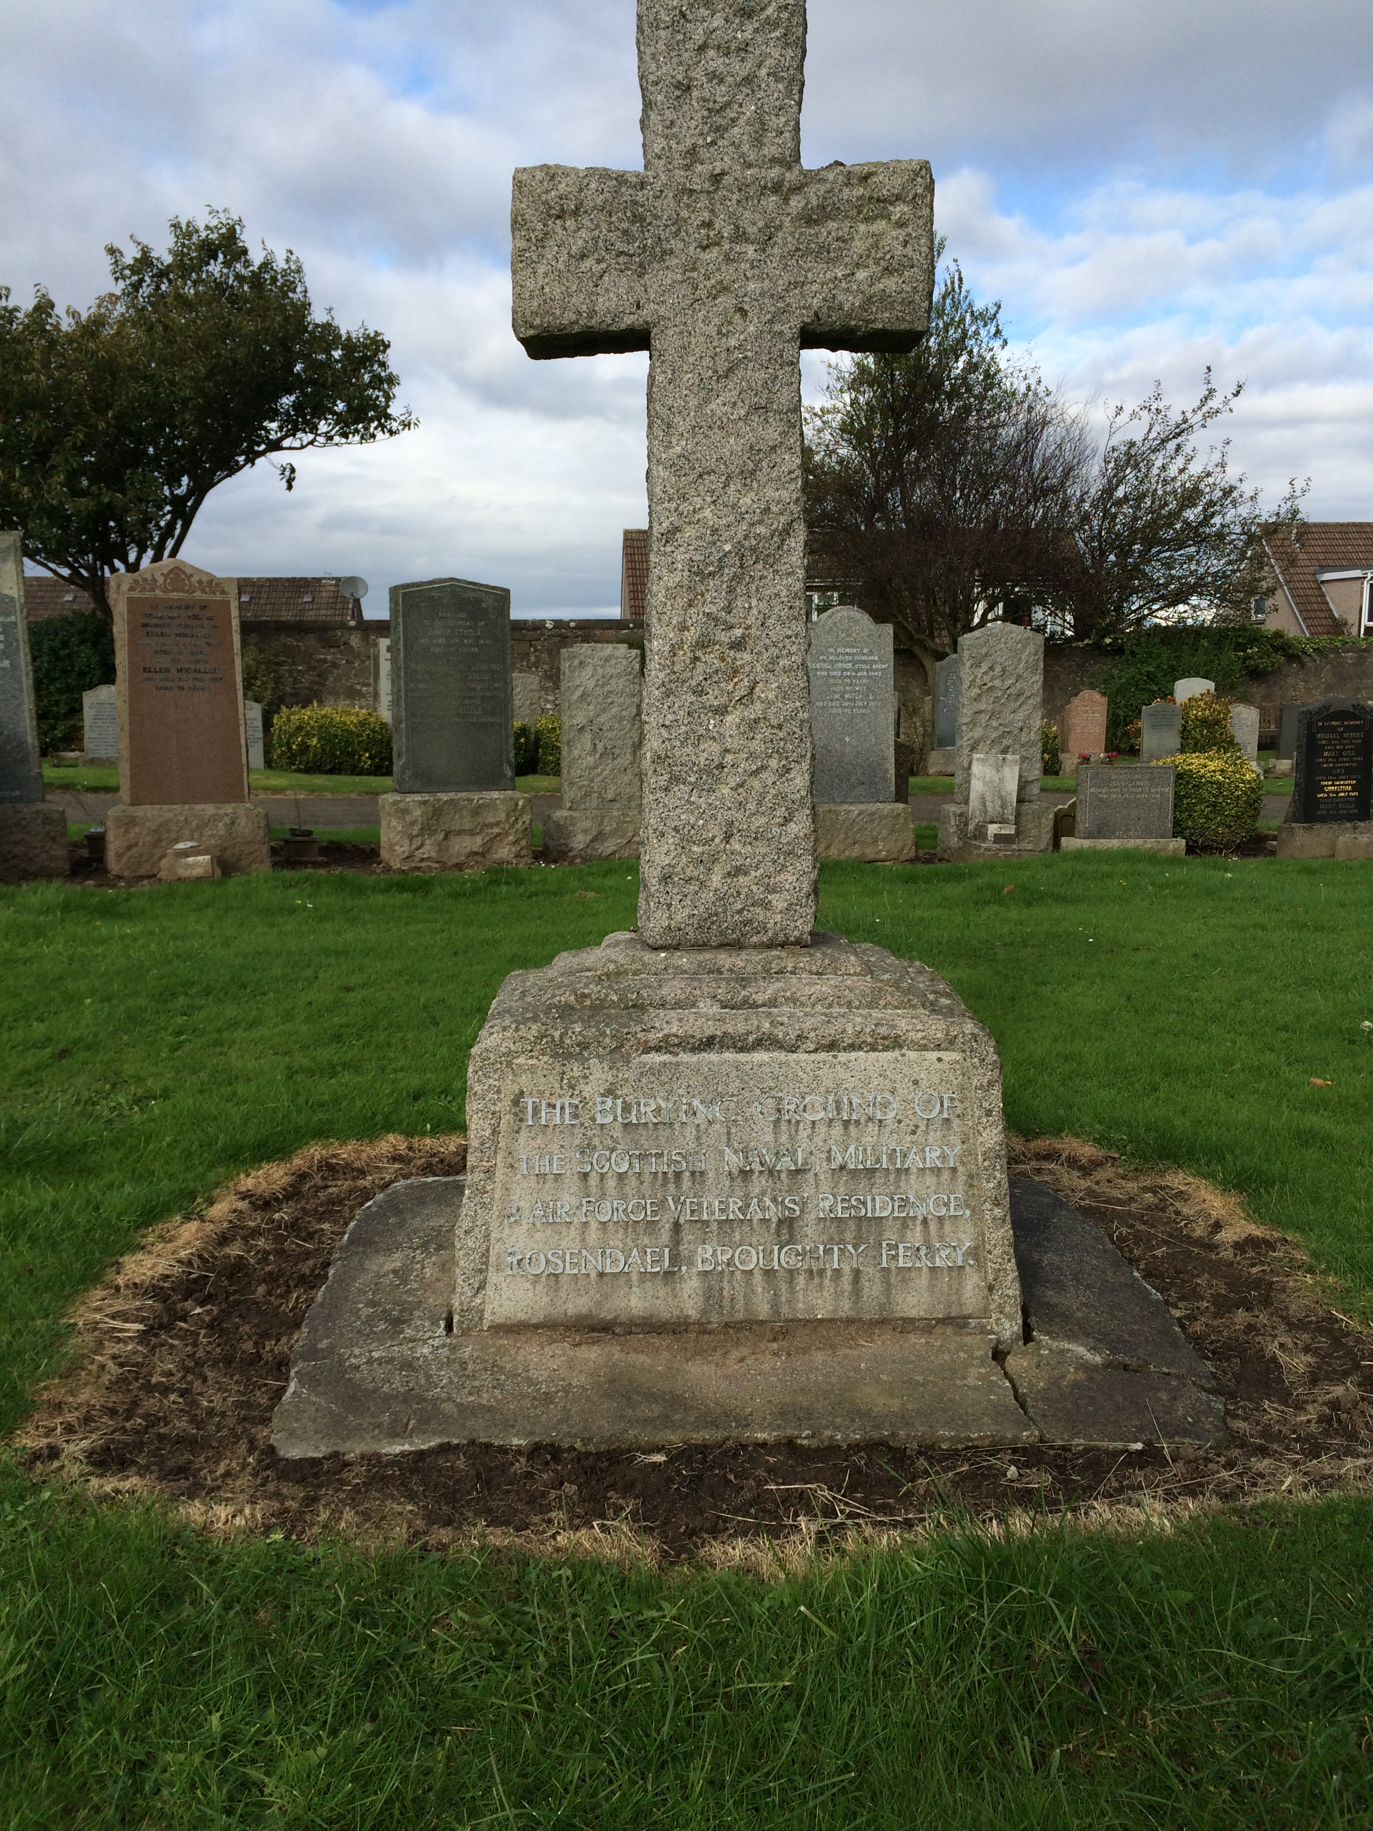
Today’s Reading: Mark 8: 31-39
The story tells us that Jesus was talking to his friends, the disciples, explaining to them that following him was not an easy job to do. In fact, he said it was dangerous at times.
Jesus also told the disciples that he knew he was going to suffer and die.

Slide 3
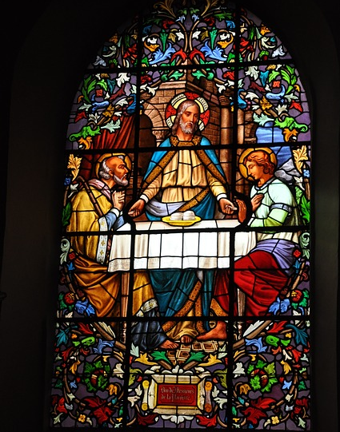
What does this mean?
Imagine that you were looking at a church window- many of them have stained glass or are made up of small pieces of glass in a pattern.
They must be difficult to make- lots of parts to work on to create the pattern with colour and then to fit it together. Very difficult.

Slide 4
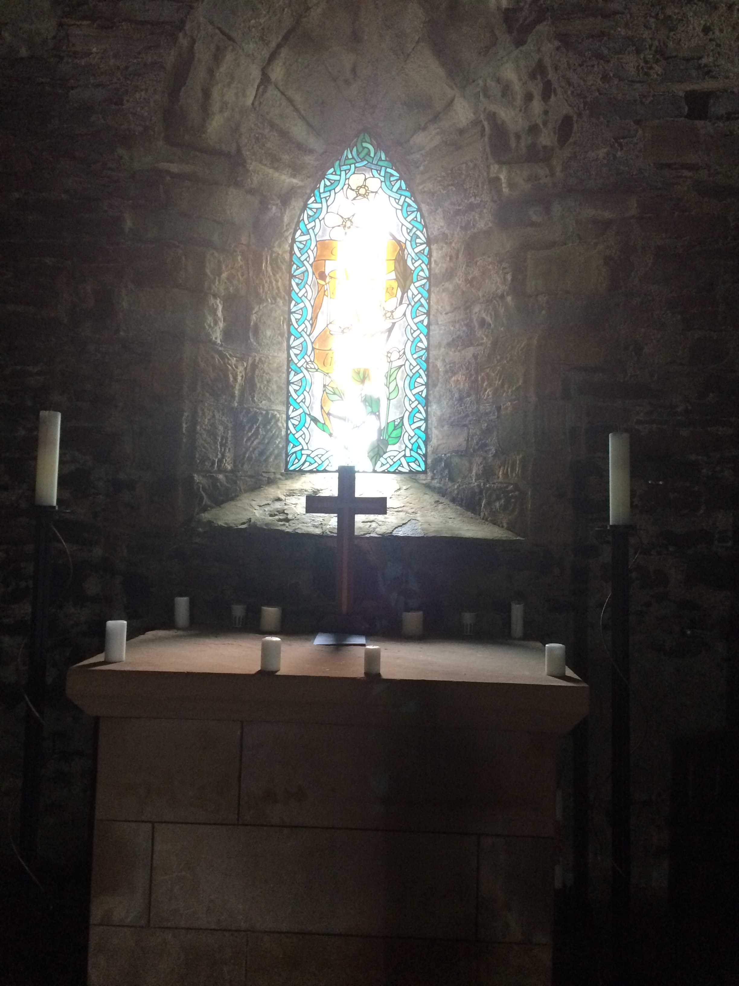
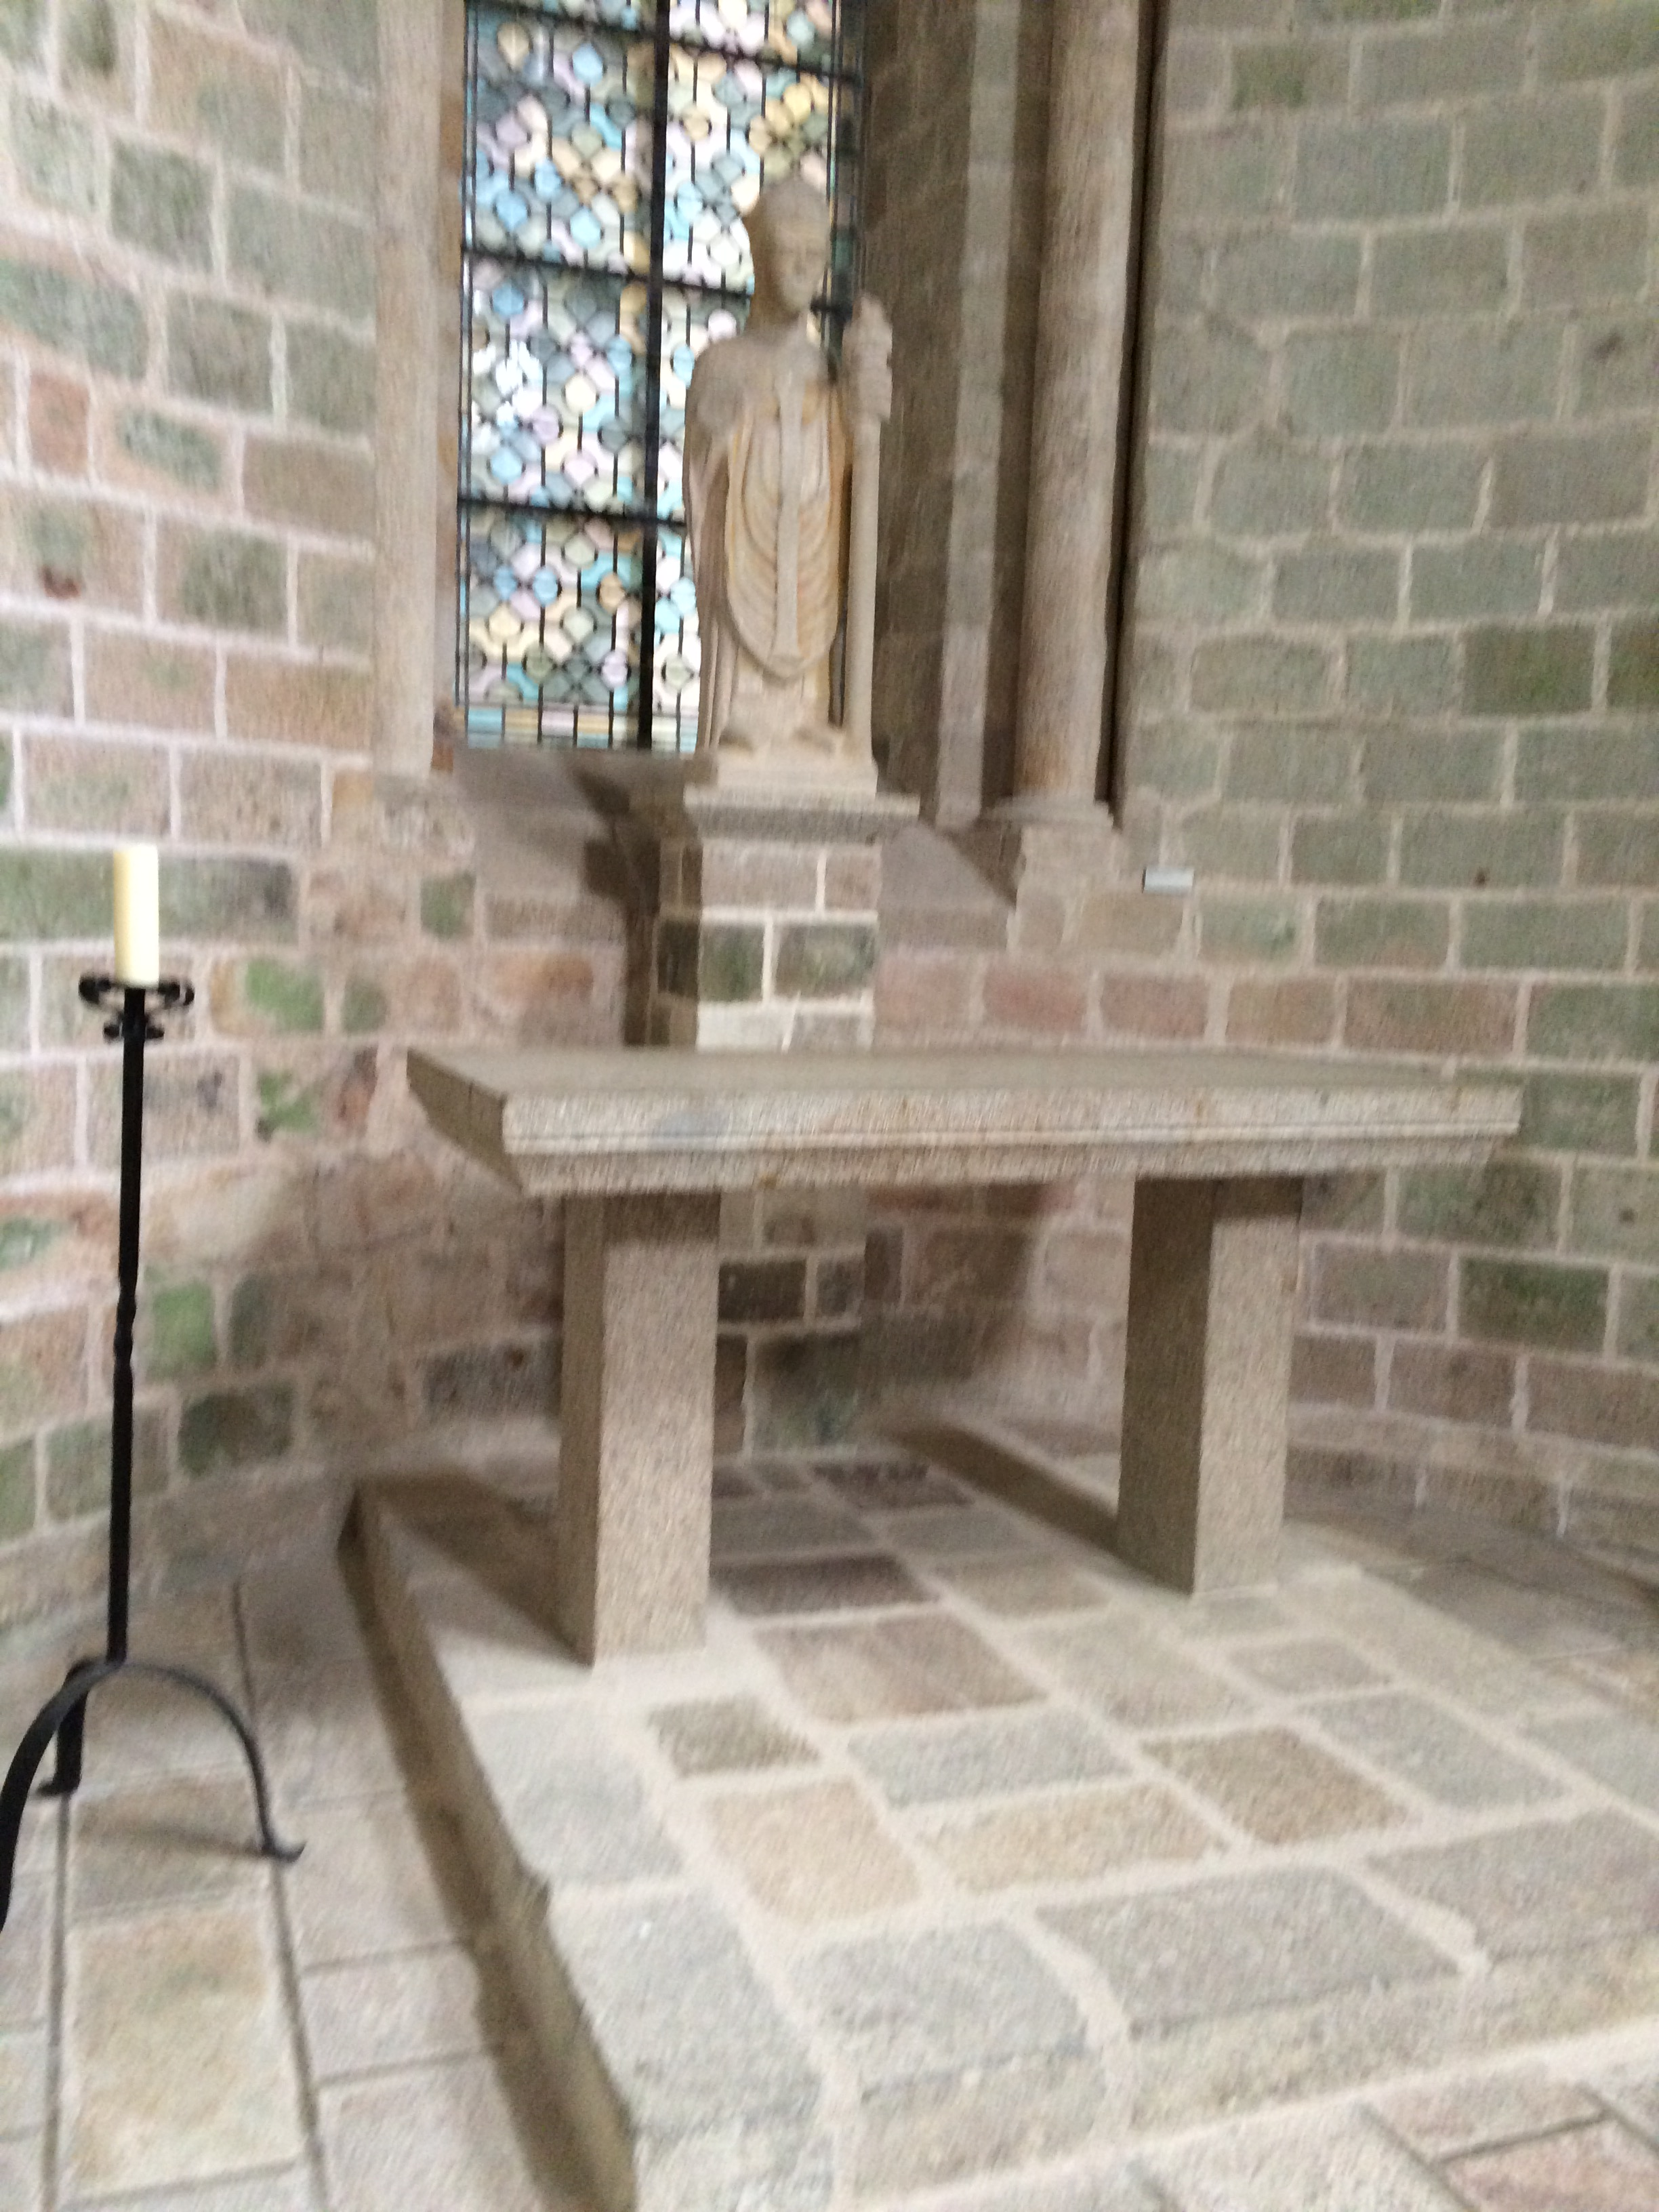
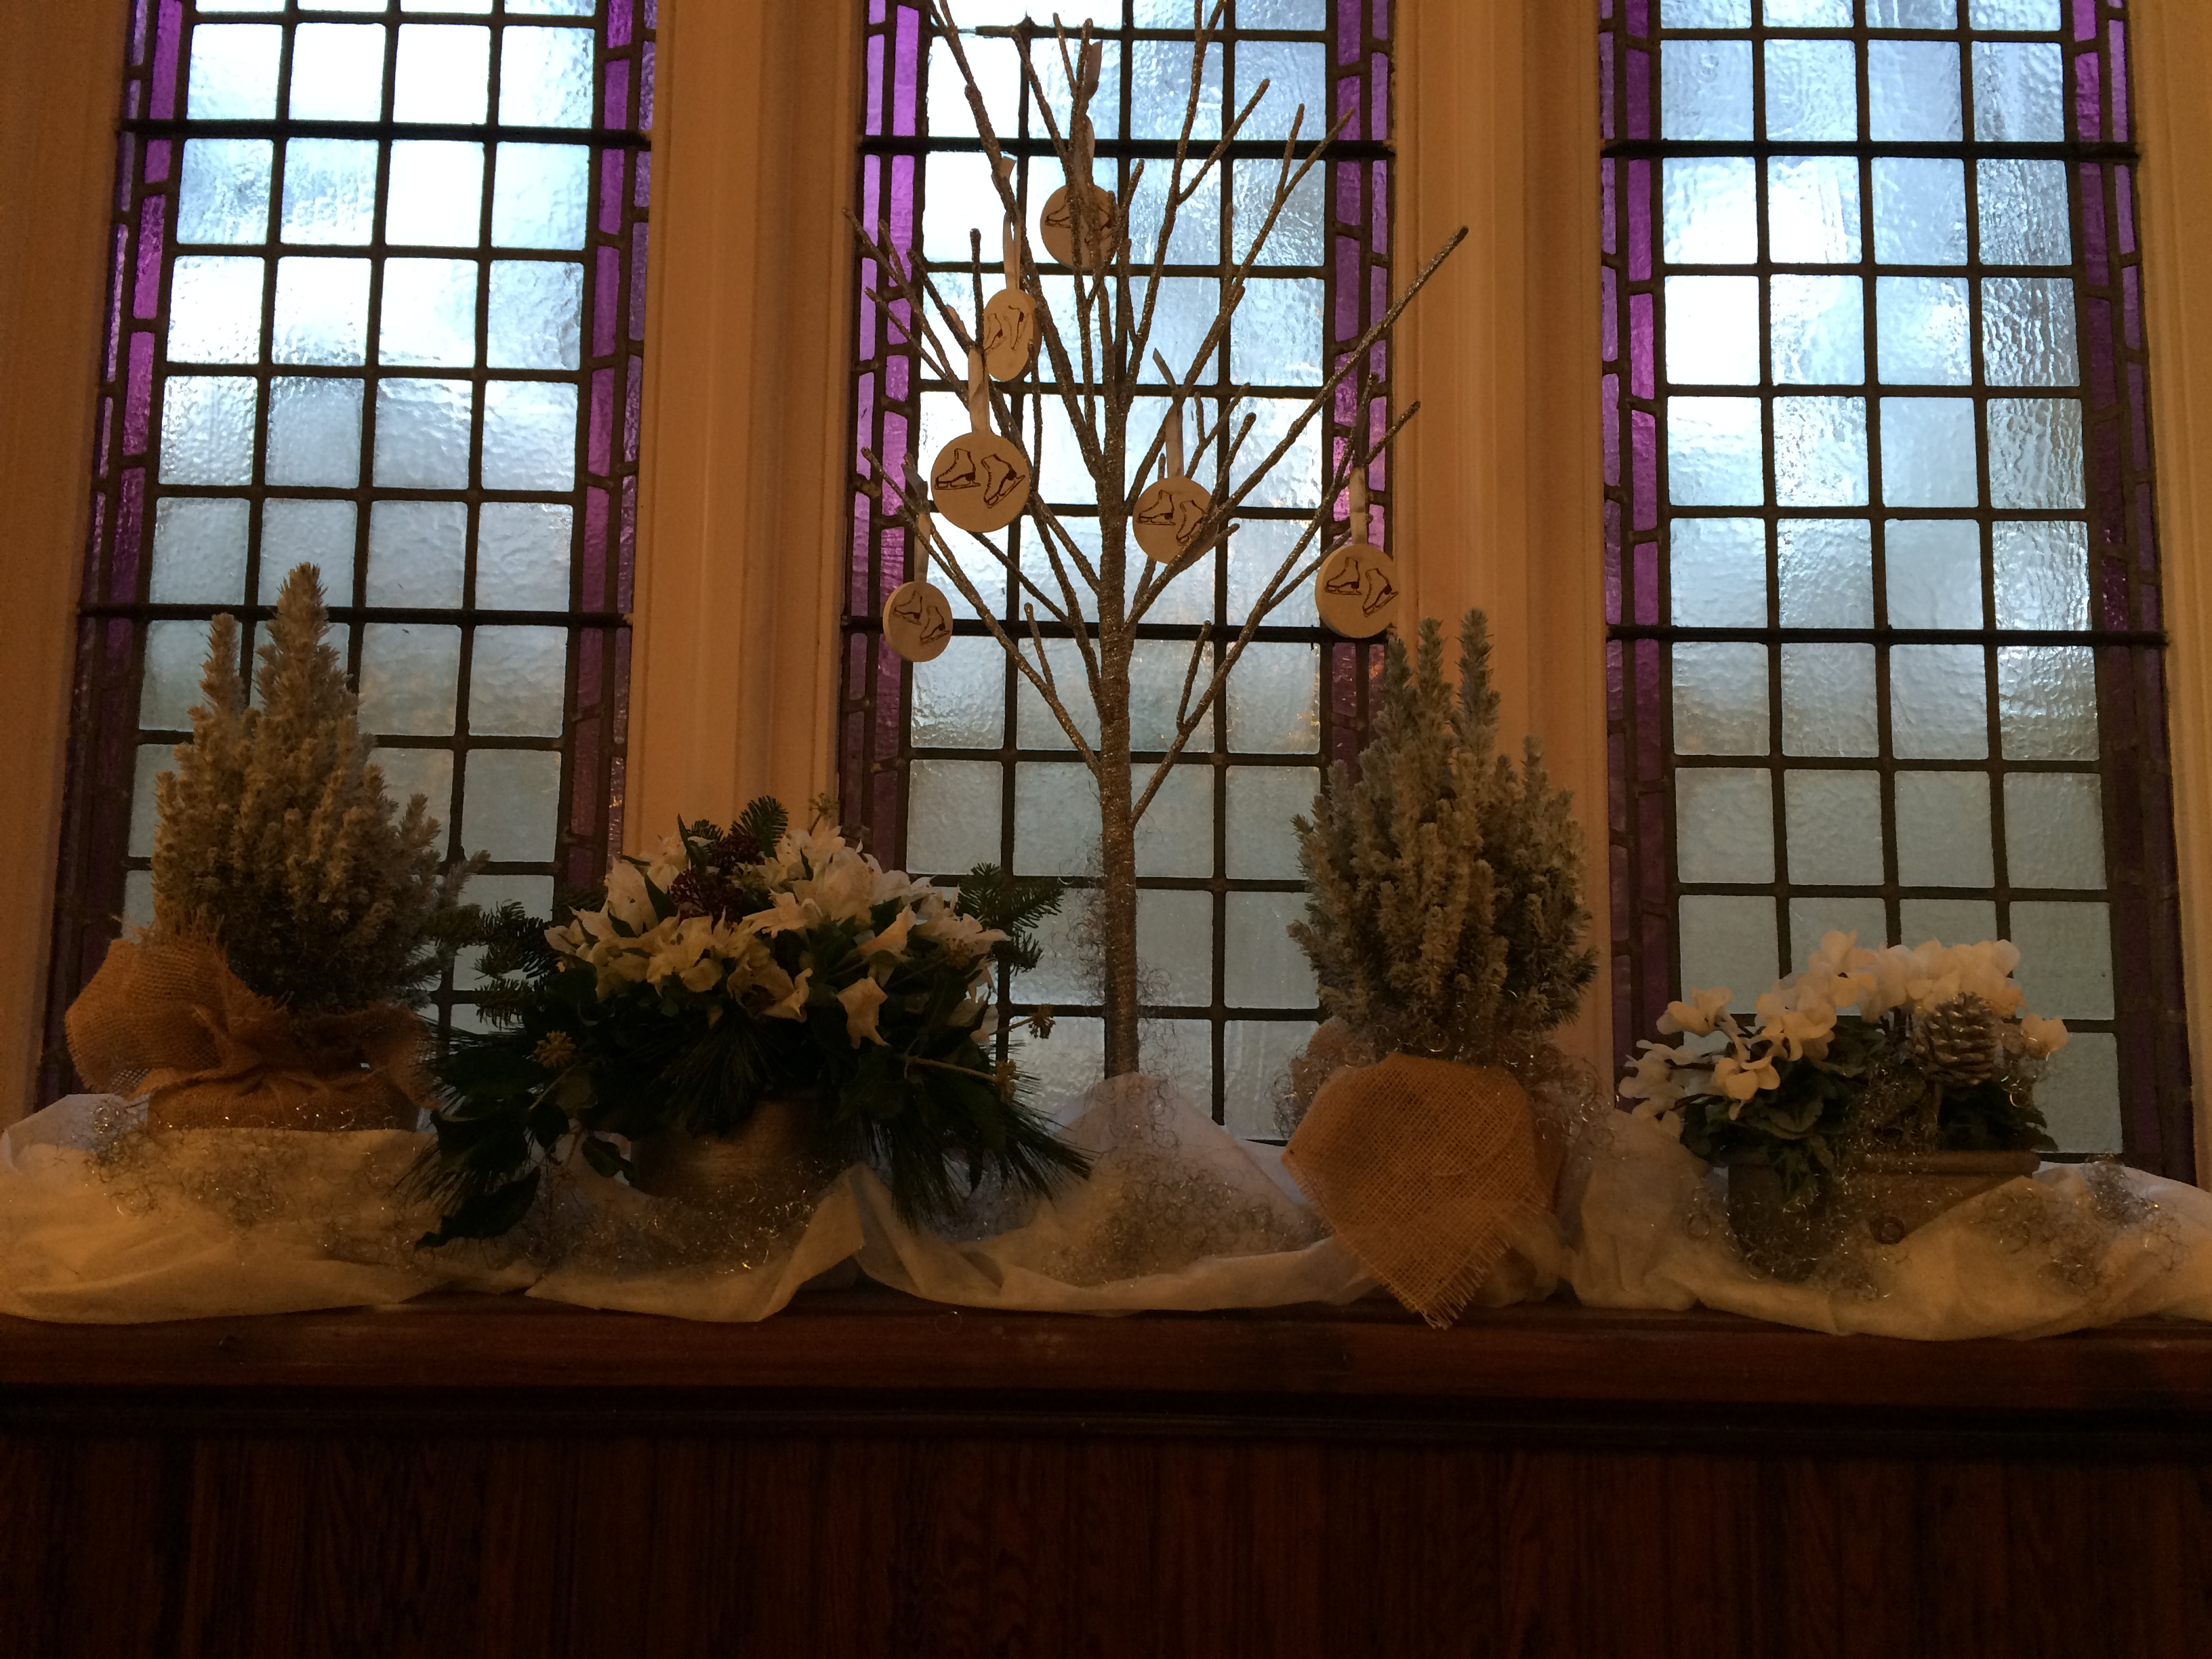
Look at some of the windows I found
Look at the edges
Look at the light coming through
Another style

Slide 5

How does this help us?
Jesus wants us to know that if we follow him, life may not always be easy.
He wants us to know, that if we do, it will be worth it (just like the windows)- in the end, they are beautiful.

Slide 6
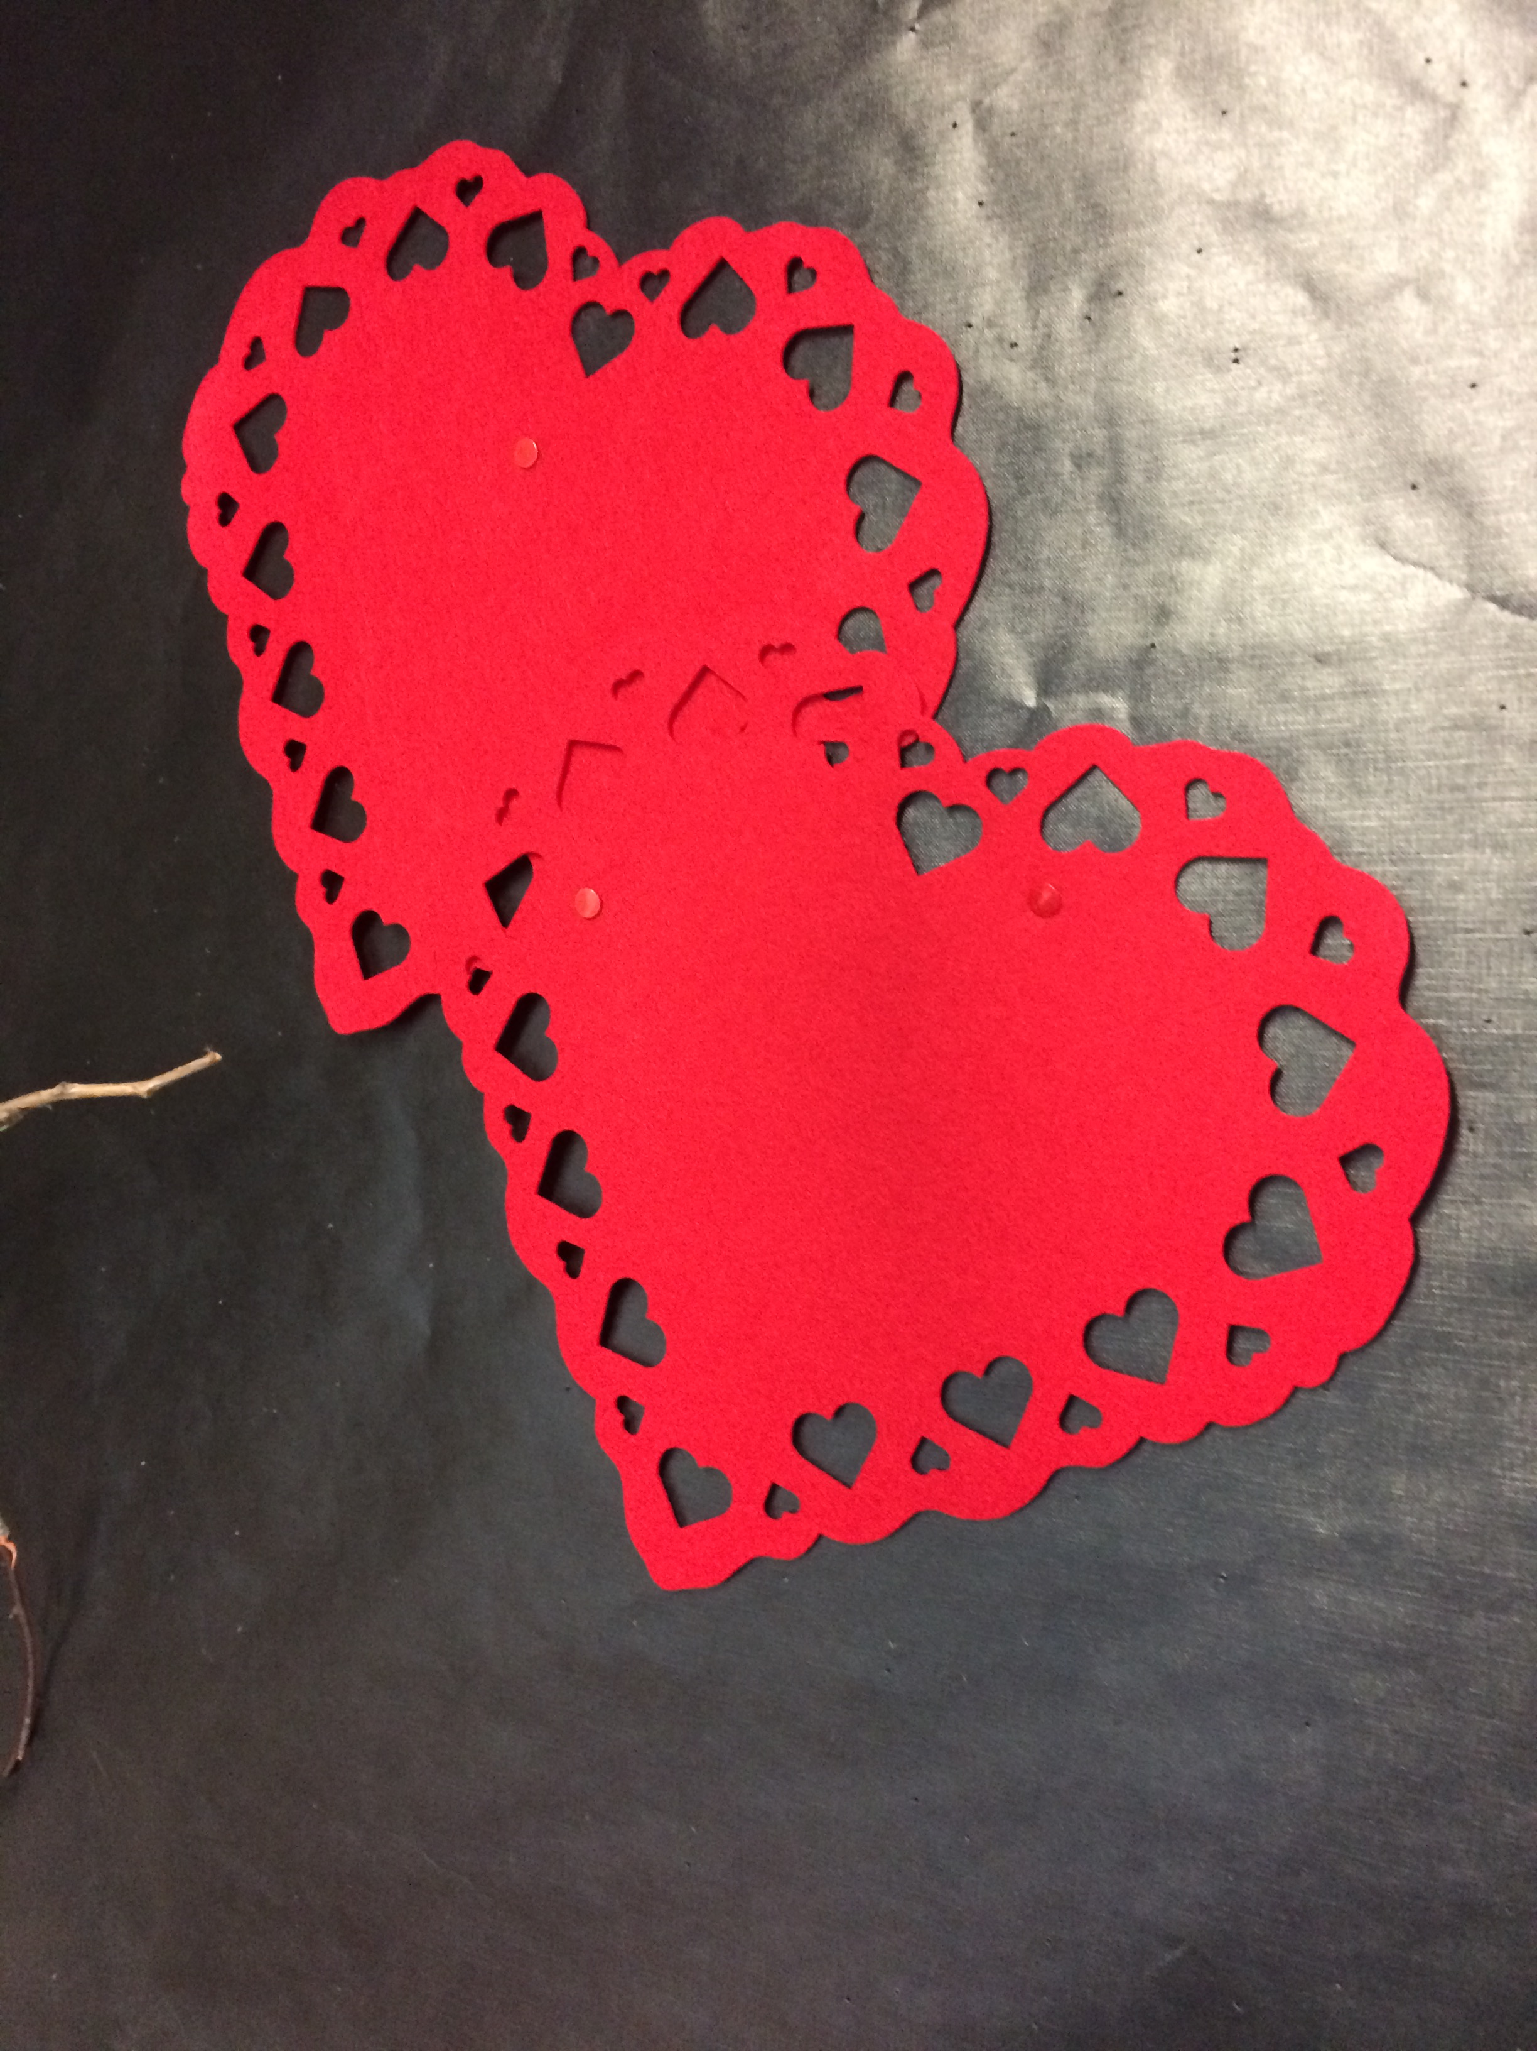
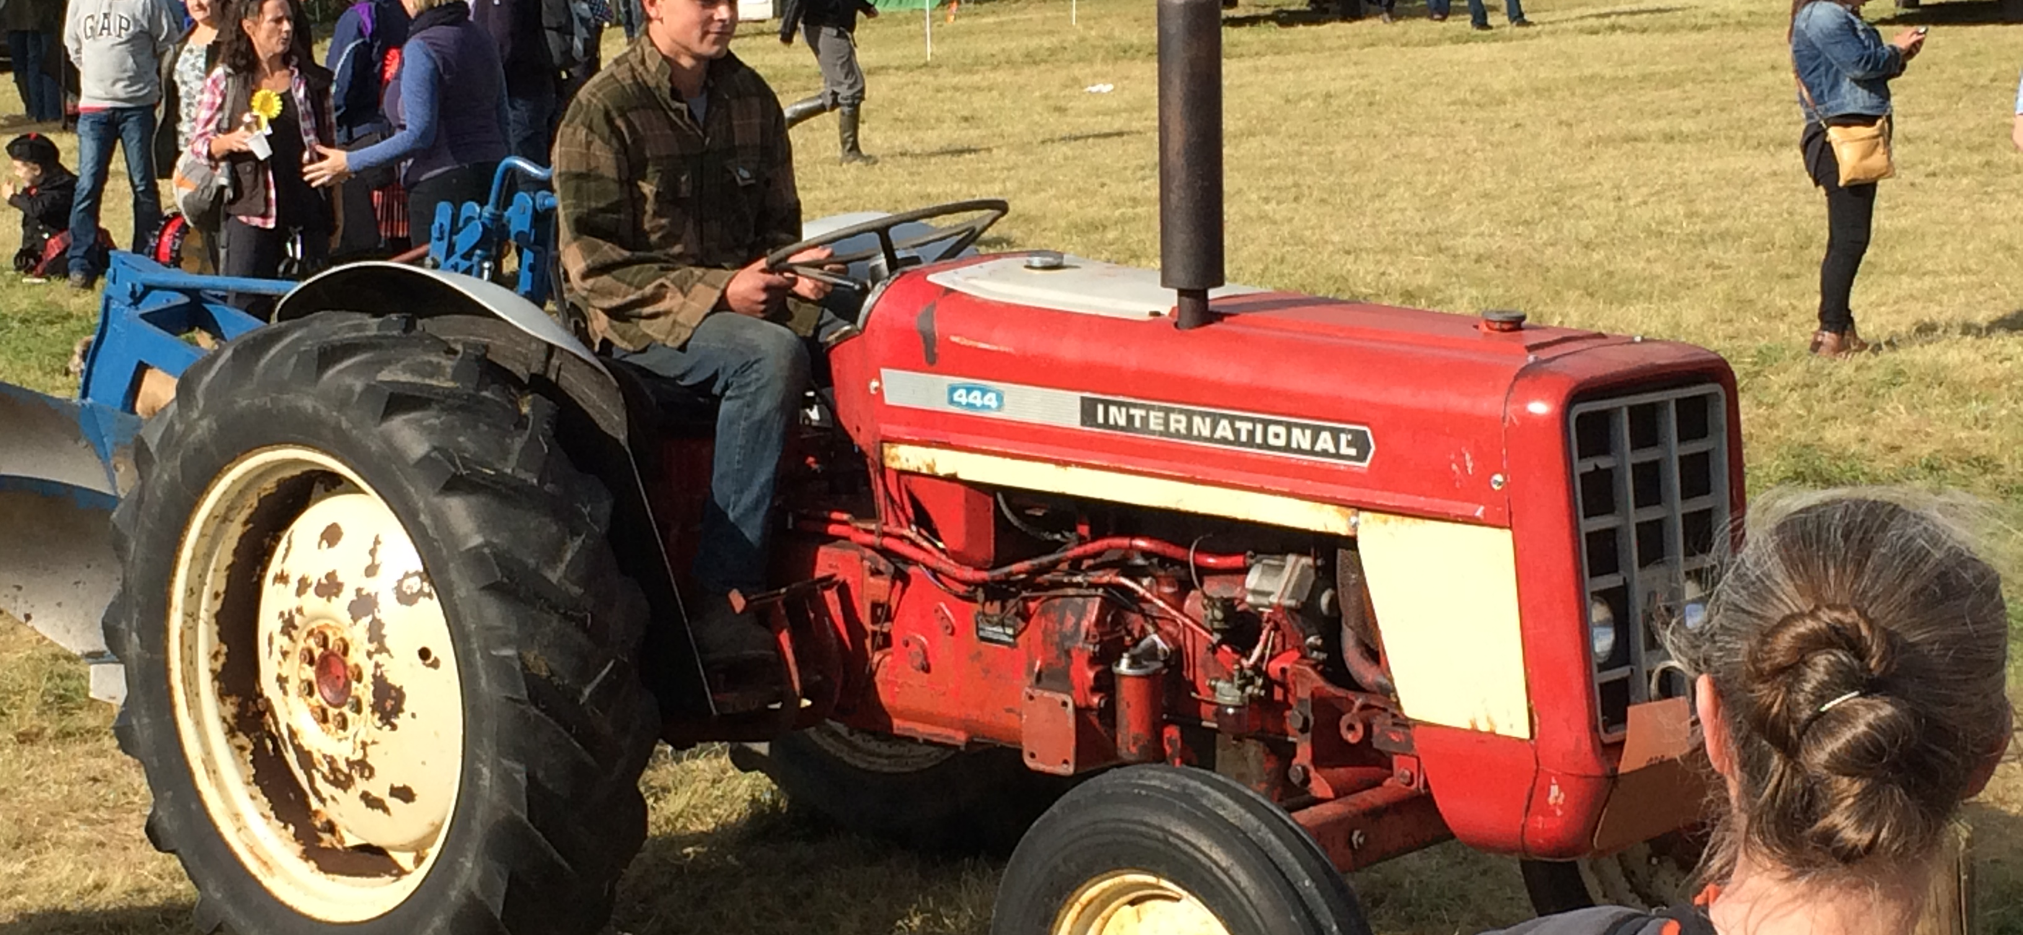
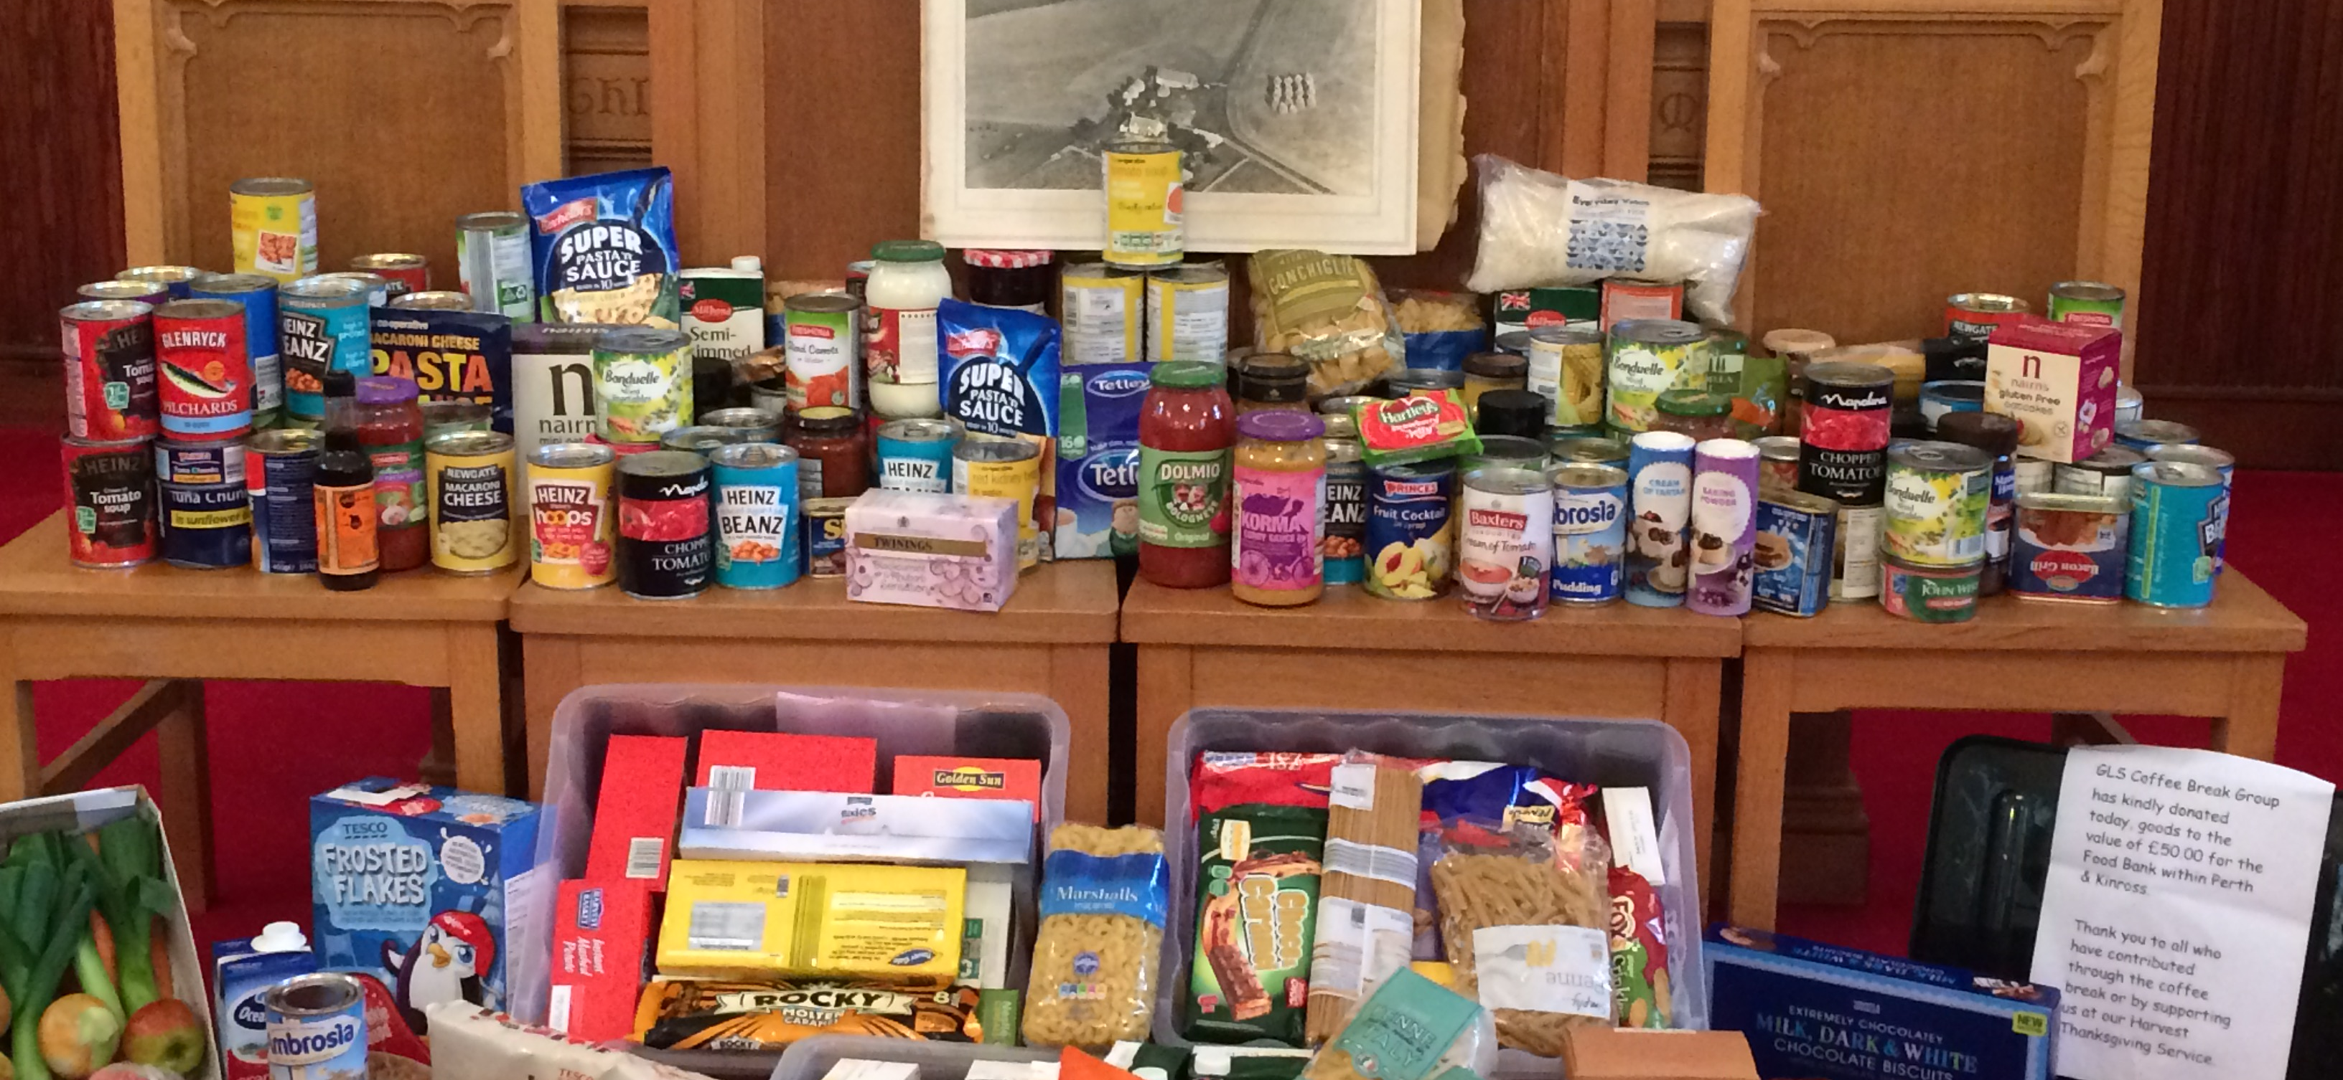
What do we need to do with our lives?
Work Hard
Be kind
Show love
Try hard at school and home
Small acts of kindness like giving a smile, saying good morning, make a difference in peoples lives
Remember always to care for our neighbours here and across the world. We can do this by praying.

Slide 7
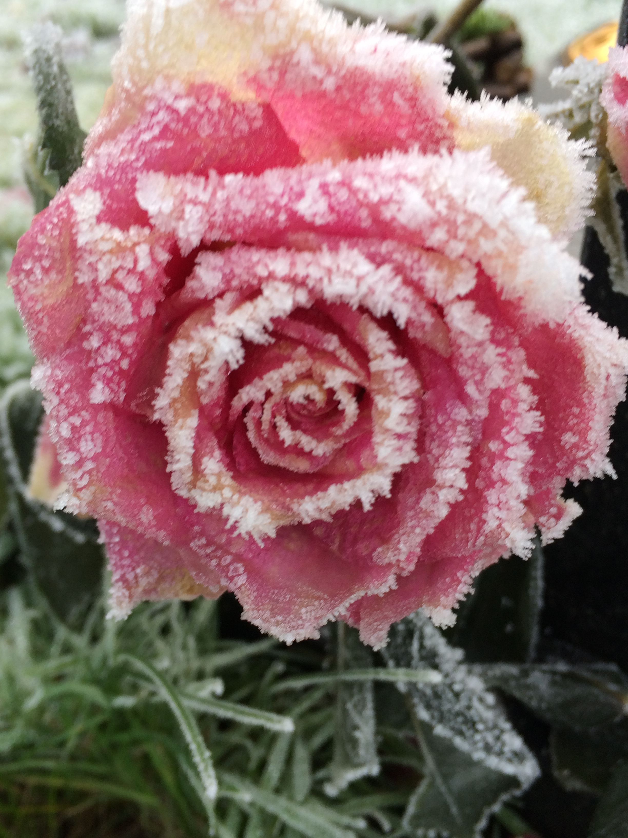
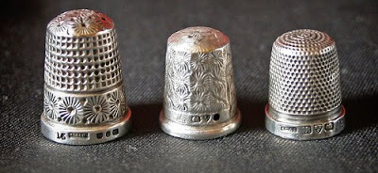
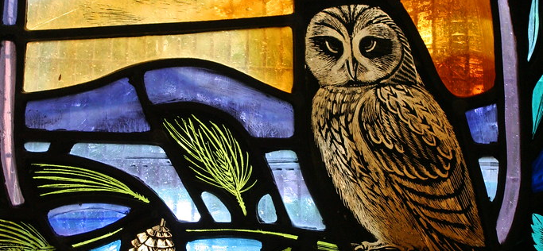
What is our task activity for today?
This Photo by Unknown Author is licensed under CC BY-SA-NC
This Photo by Unknown Author is licensed under CC BY
Play a Game
Search during the week
Share the light
Play hunt the thimble.
Like going on a journey to find something!
When out and about, look for a stained glass window- if you find one do take a photo.
Windows let through light. God is the light of the world. Show someone, something wonderful that God has created eg a flower, a bird,

Slide 8
Dear God,
Bless all our Sunday club members and readers, as we journey with you this week. Thank you. Amen
Have a Good Week
From GLS SUNDAY CLUB

